Slide 1


BUA 751: Machine Learning for Business Homework 1: Medical Analysis
Group 6:
Shiva Dhanush Mallela
Sravan Kumar Mandhadapu
Rishi Siddanth Yaga
Harshitha Reddy Yerramorrusu

Slide 2
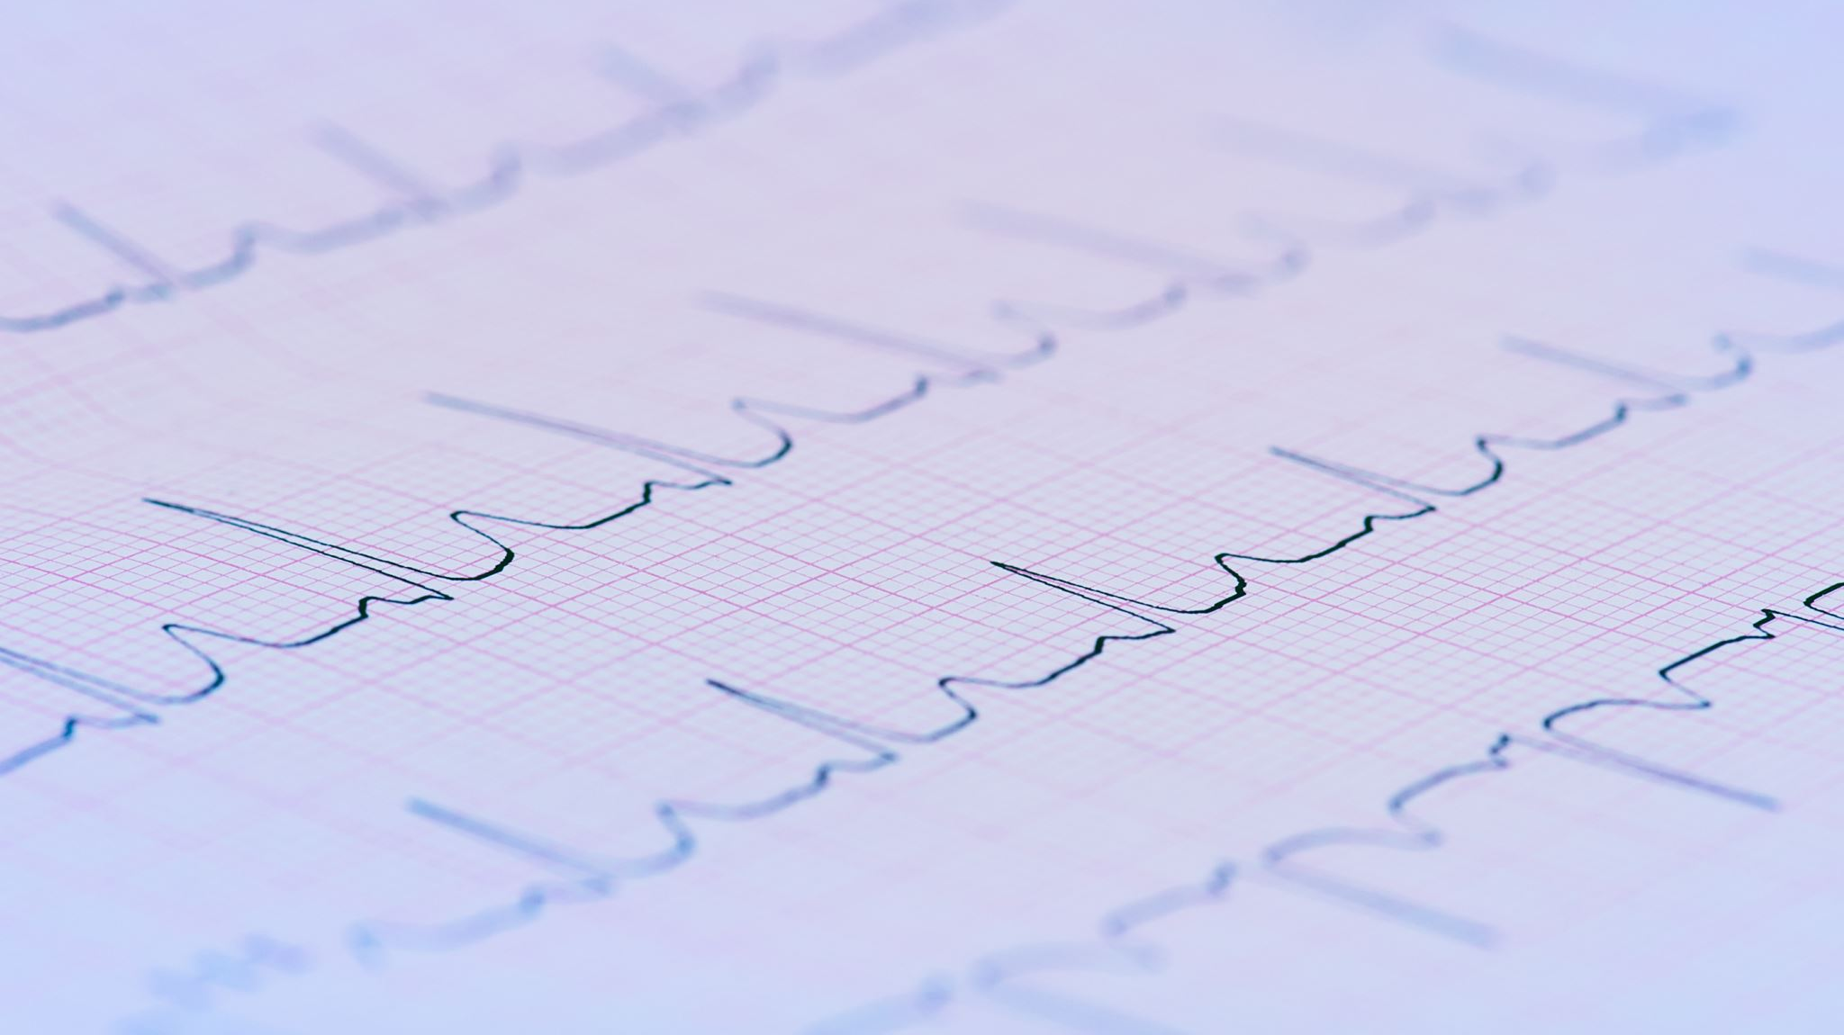
DATASET – HEART FAILURE
This information came from the repository of machine learning datasets at the University of California, Irvine. This dataset includes the following data fields:
Data Fields:
Patient age – age of the patient in years.
Anemia – decrease of hemoglobin or RBCs (Boolean).
High Blood Pressure – hypertension (Boolean).
Creatinine phosphokinase – level of CPK enzyme in blood(mcg/L).
Diabetes – if the patient has diabetes(Boolean).
Ejection fraction – percentage of blood leaving the heart at each contraction(percentage).
Platelets – platelets in blood.
Sex – Gender.
Serum creatinine – levels of serum creatinine in blood (mg/dL).
Serum sodium - levels of serum sodium in blood (mEq/L).
Smoking – smokes or not (Boolean).
Time – follow-up period (days).
Death Event – fatality (Boolean).

Slide 3
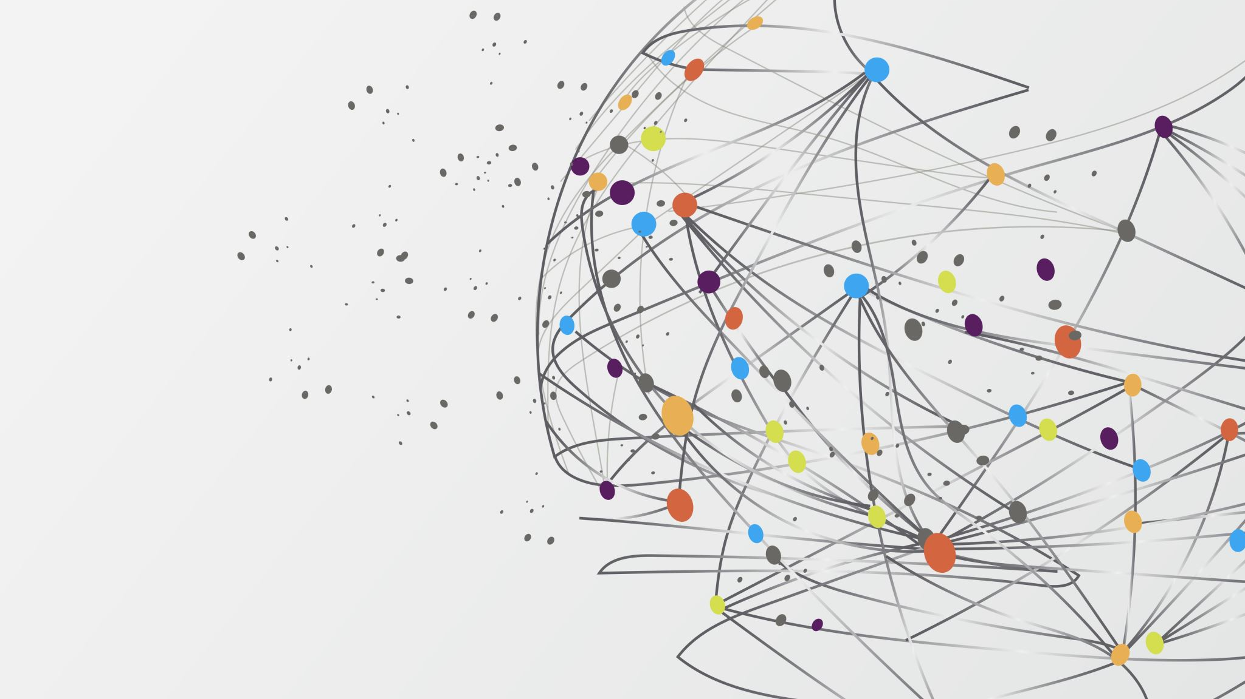
VISUALIZATIONS

Slide 4
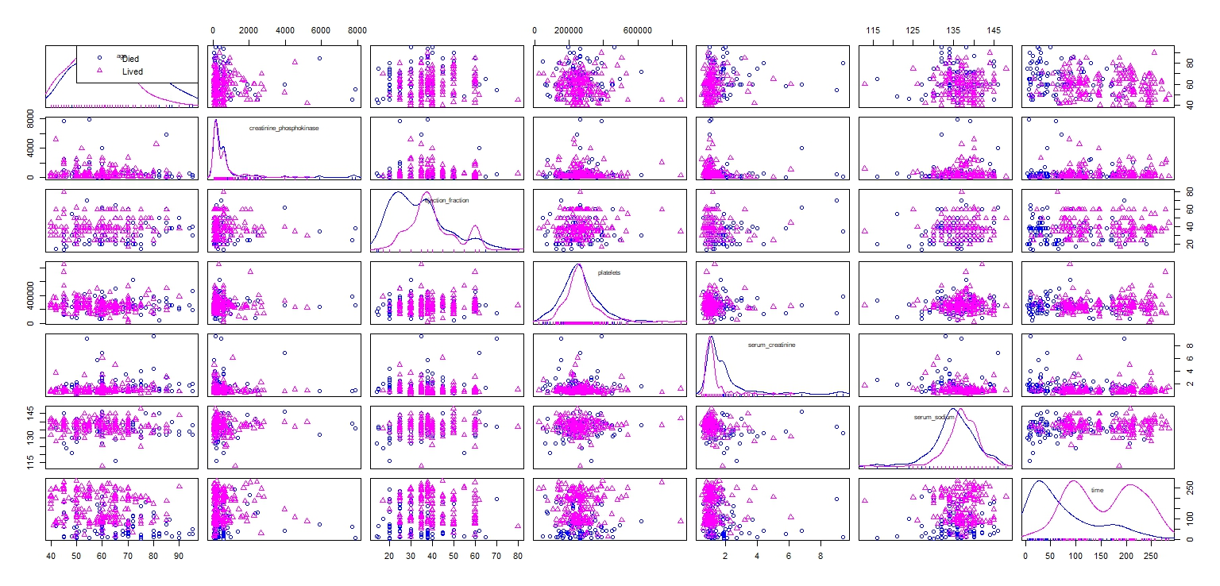
The scatterplot matrix depicts the overall view of relationship between all the continuous variables and the dependent variable(DEATH EVENT).

Slide 5
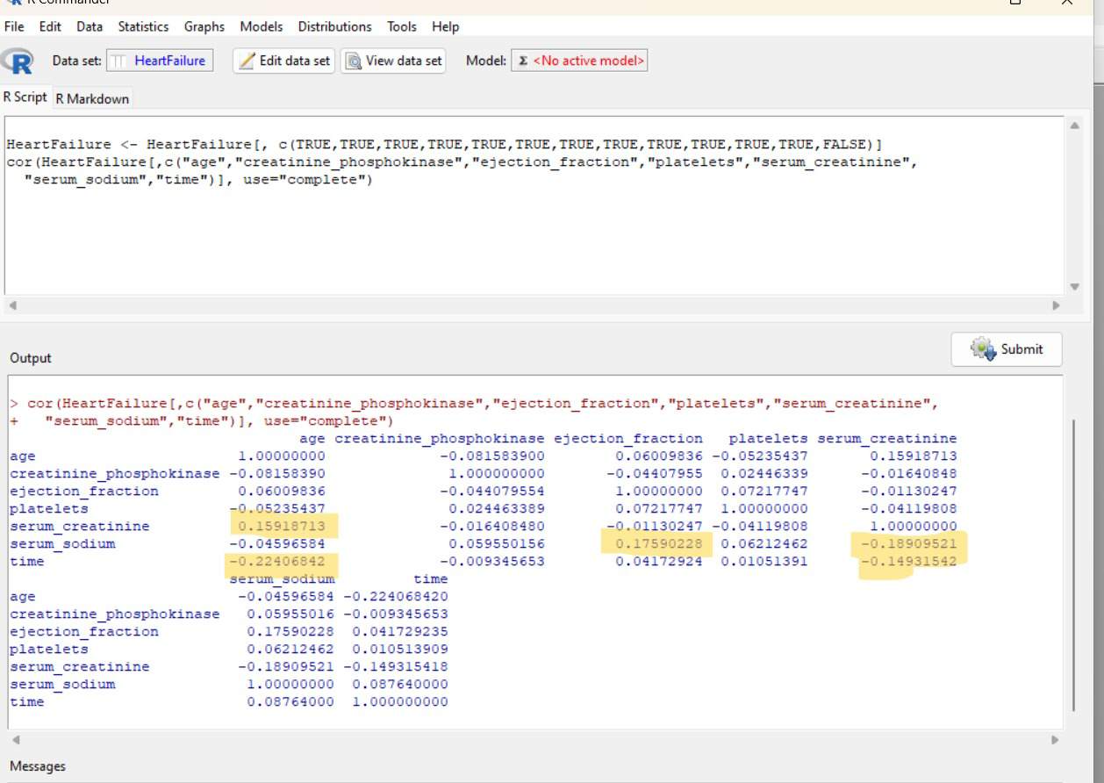
Correlation

Slide 6
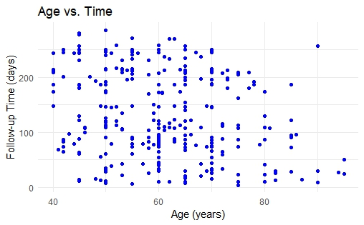
This is a scatter plot graphing the relationship between two variables: 'Age' on the x-axis and 'Follow-up Time (days)' on the y-axis.
jdd

Slide 7
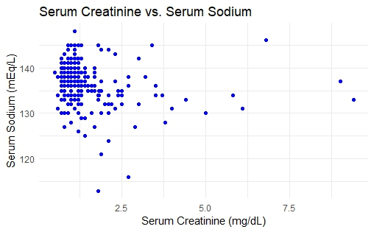
This graph is a scatter plot displaying the relationship between 'Serum Creatinine' levels on the x-axis and 'Serum Sodium' levels on the y-axis.
fff

Slide 8
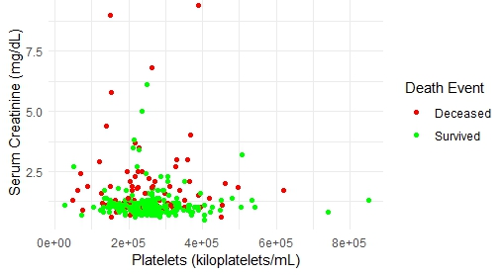
This graph is a scatter plot displaying the relationship between ‘Platelets’ on the x-axis and 'Serum Creatinine ' on the y-axis.

Slide 9
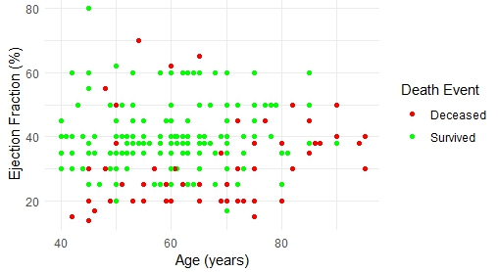
This graph is a scatter plot displaying the relationship between ‘Age’ on the x-axis and ‘Ejection Fraction' on the y-axis.

Slide 10
PERCEPTRONS

Slide 11
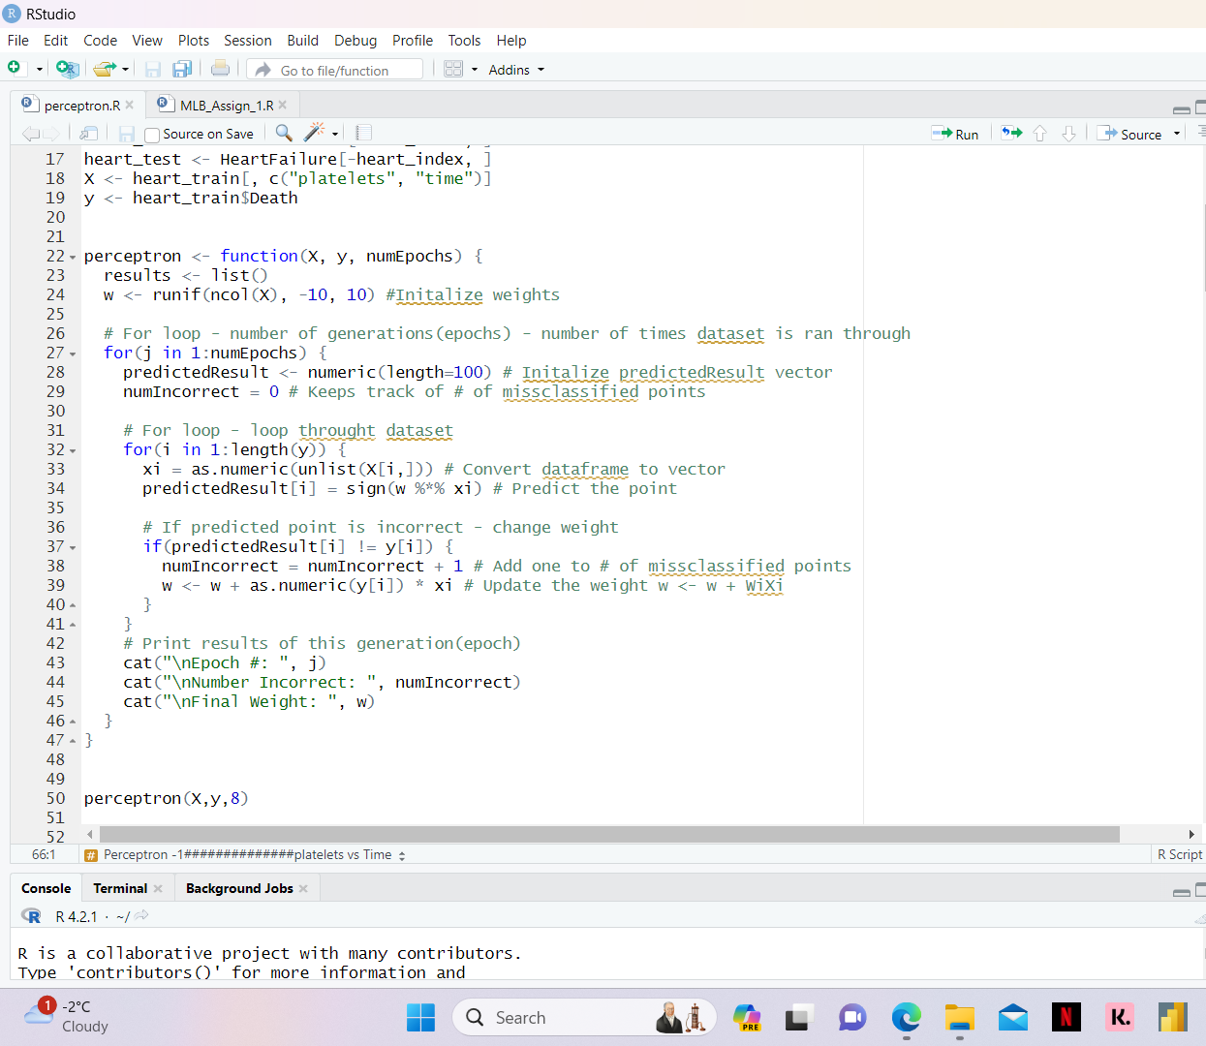
PERCEPTRONS
We divided our dataset into a training set (70%) and a test set (30%) to train and evaluate a perceptron model. During training, the perceptron learns from the training data to predict death events in patients. Subsequently, we use the test set to assess the accuracy of the predictions made by the perceptron. This process helps us understand how well the perceptron performs in predicting death events based on the features in the dataset.

Slide 12
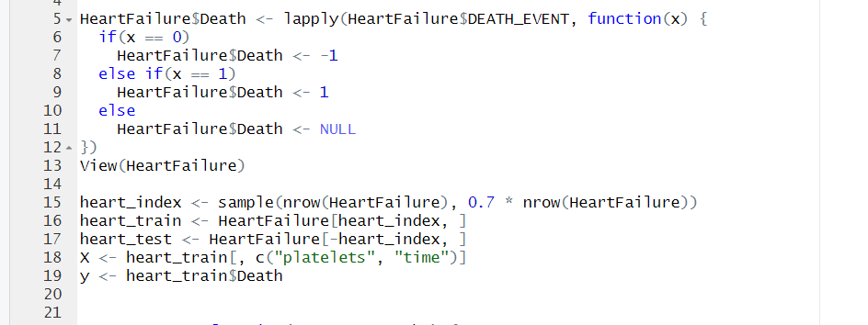
PERCEPTRON - I
For the first perceptron, we selected DEATH_EVENT as the dependent variable (Y) and two continuous variables, platelets and time, as independent variables (X).

Slide 13
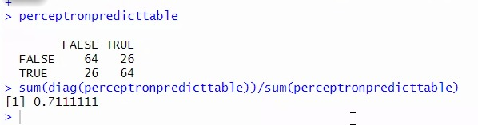
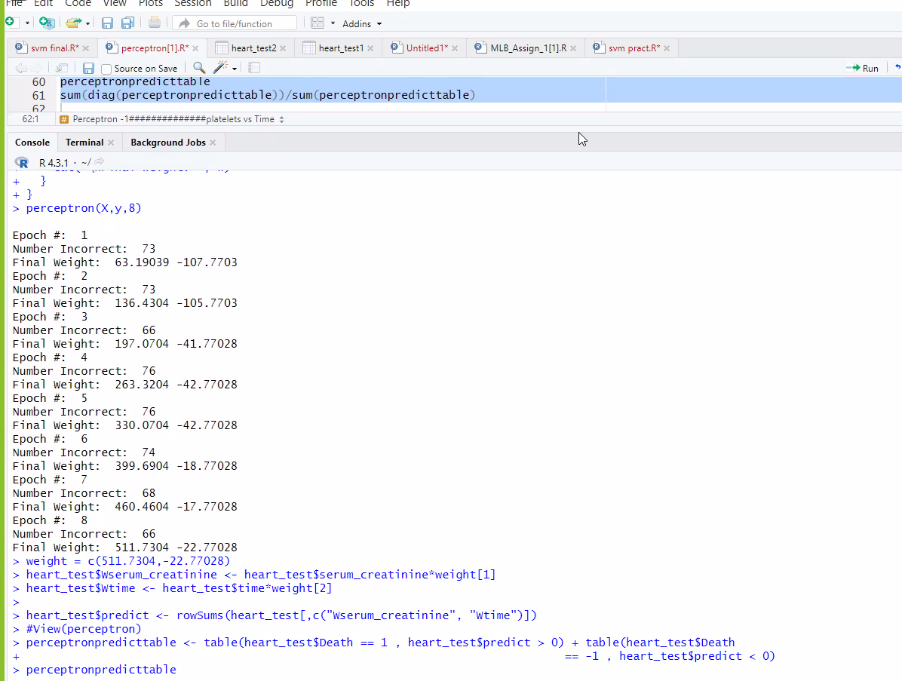
PERCEPTRON - I

Slide 14
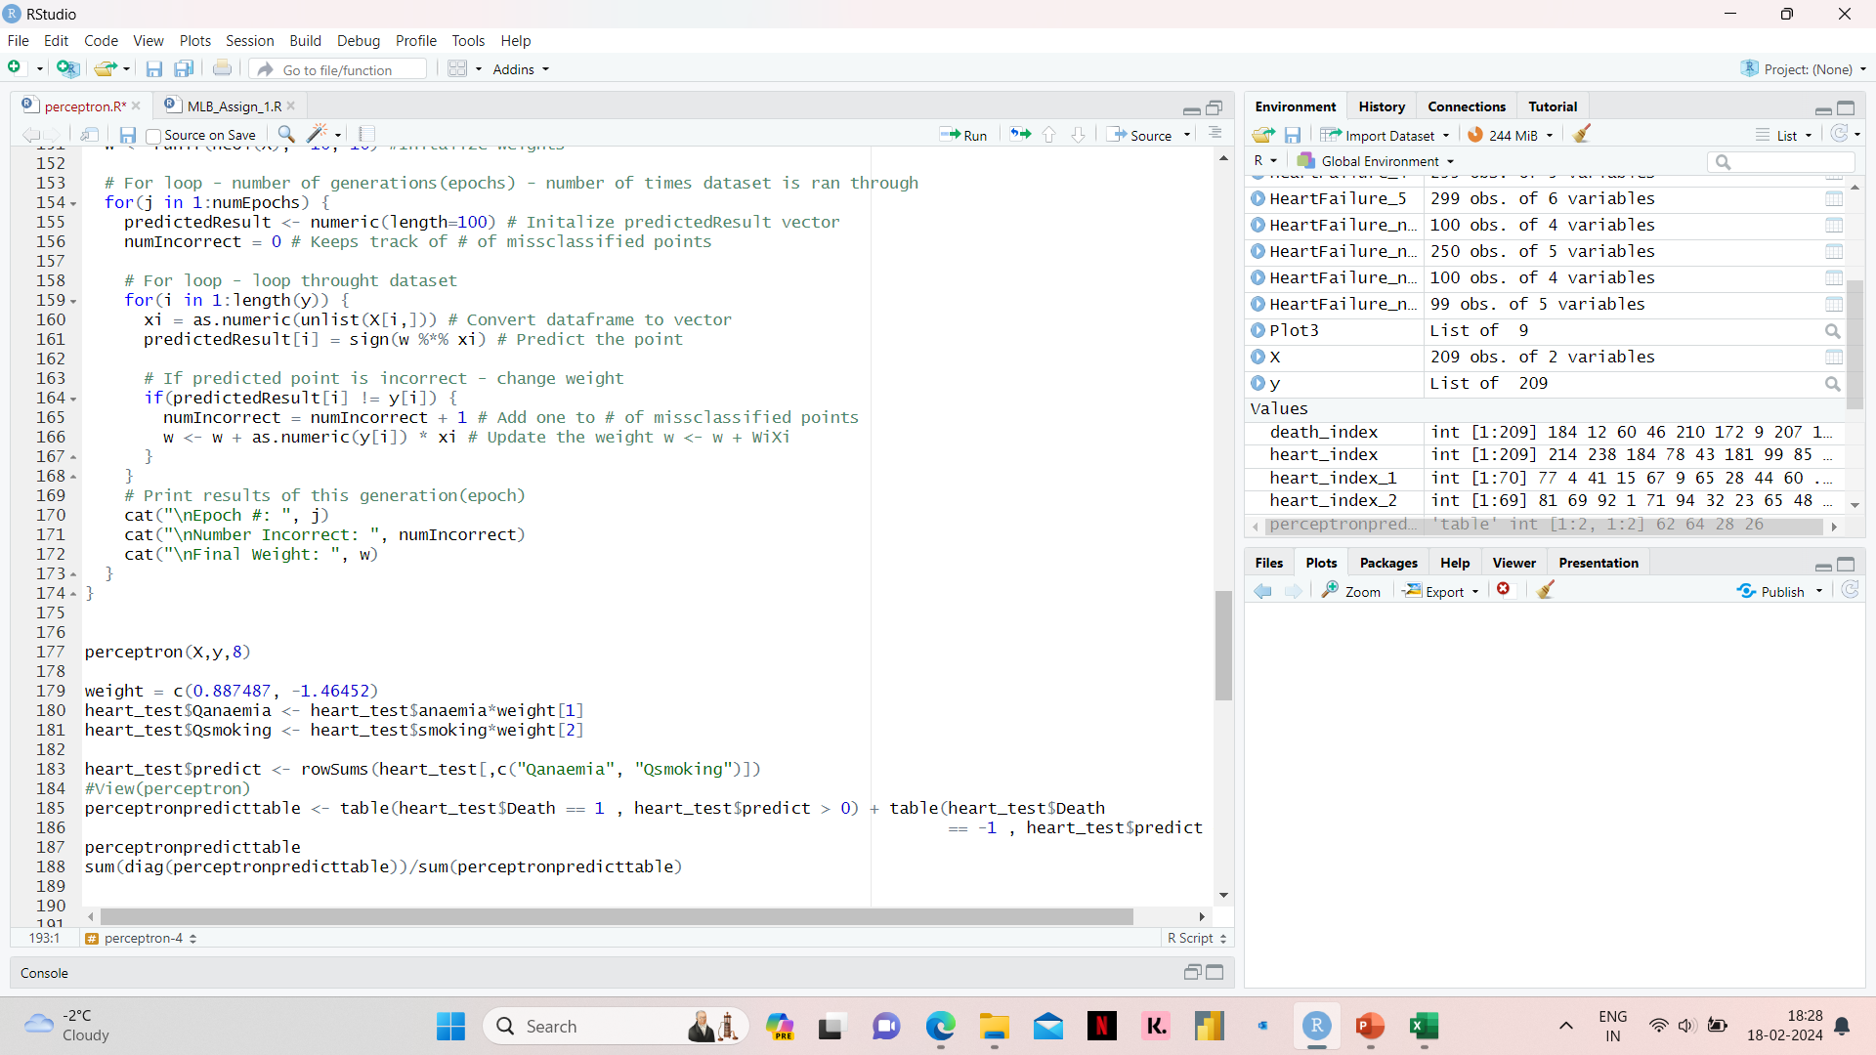
PERCEPTRON - II
For the second perceptron, we selected DEATH_EVENT as the dependent variable (Y) and two binary variables, anaemia and smoking, as independent variables (X).

Slide 15
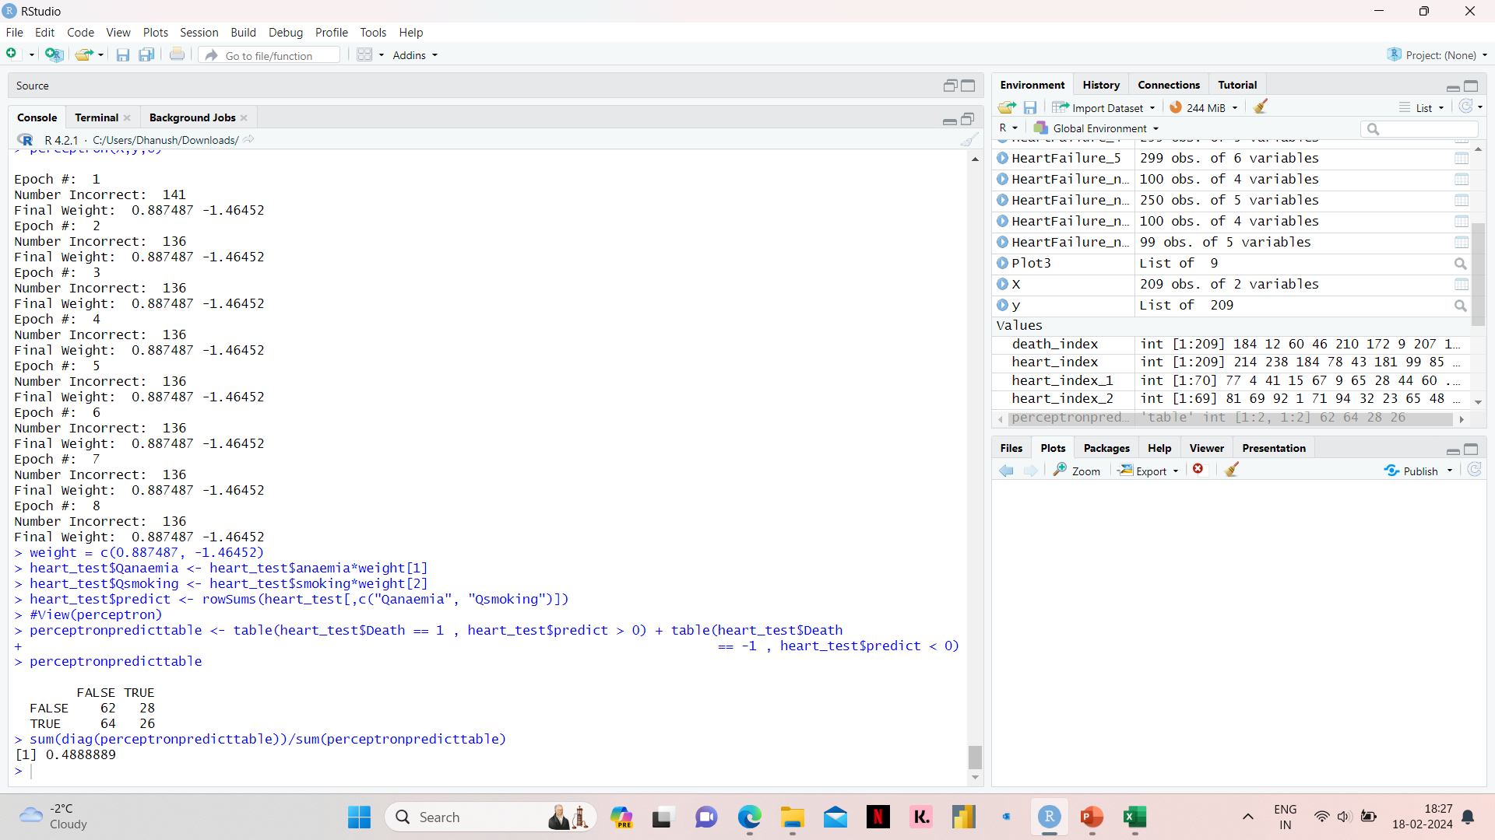
PERCEPTRON - II

Slide 16
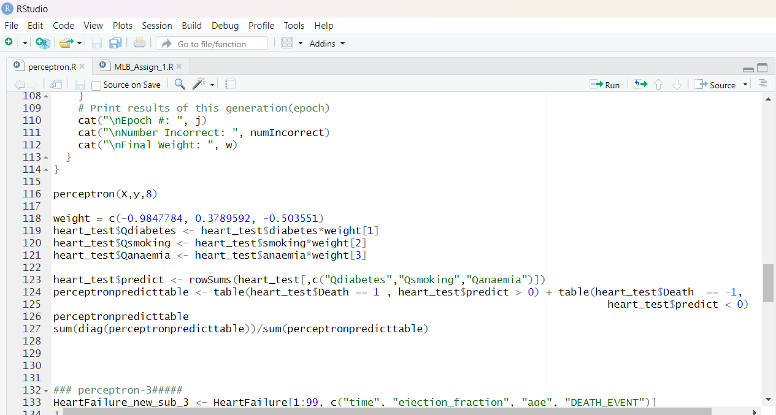
PERCEPTRON - III
For the third perceptron, we selected DEATH_EVENT as the dependent variable (Y) and three binary variables, diabetes, smoking, anaemia, as independent variables (X).

Slide 17
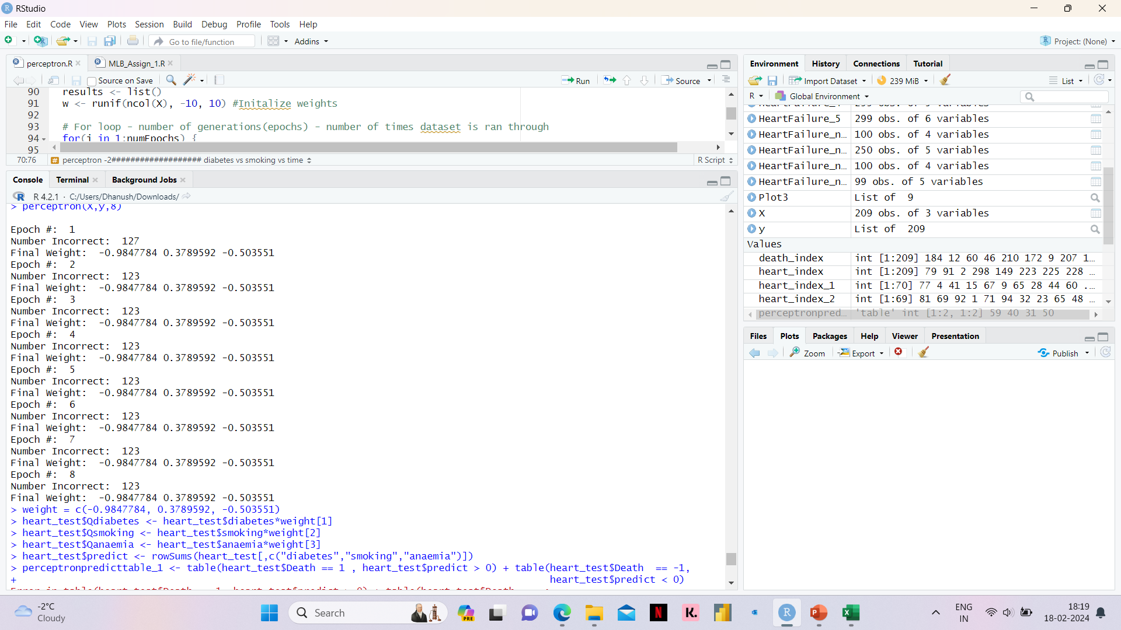
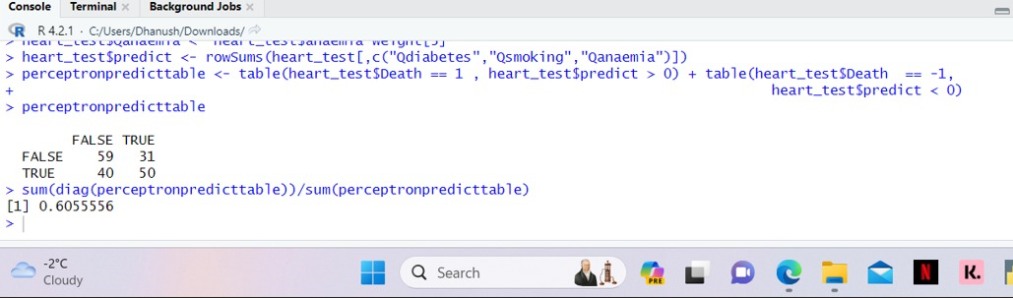
PERCEPTRON - III

Slide 18
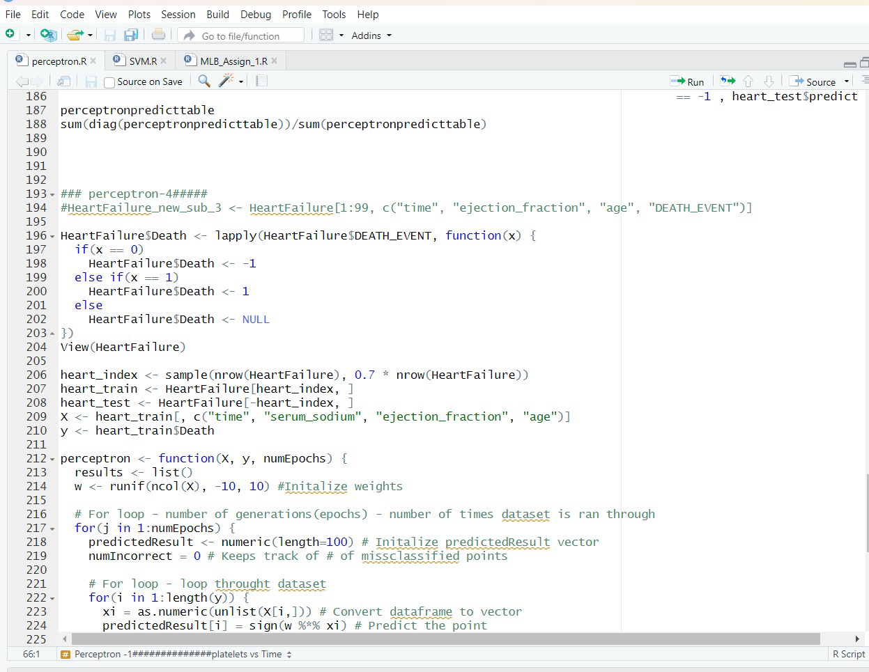
PERCEPTRON - IV
For the third perceptron, we selected DEATH_EVENT as the dependent variable (Y) and four continuous variables, Time, Serum Sodium, Ejection Fraction and Age as independent variables (X).

Slide 19
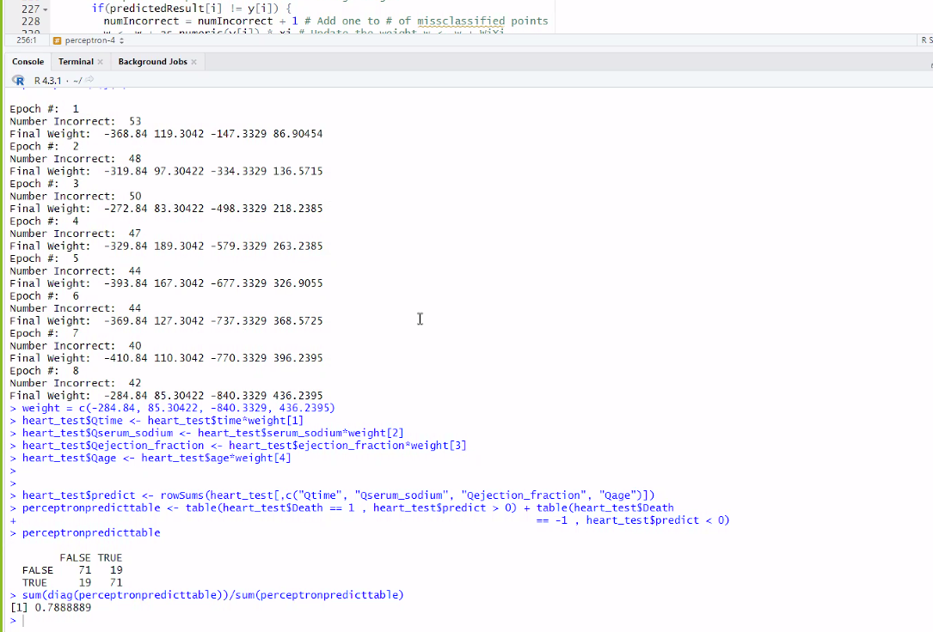
PERCEPTRON - IV

Slide 20

SUMMARY OF PERCEPTRONS
Perceptron 1
Perceptron 2
Perceptron 3
Perceptron 4

Slide 21
Support Vector Machines

Slide 22
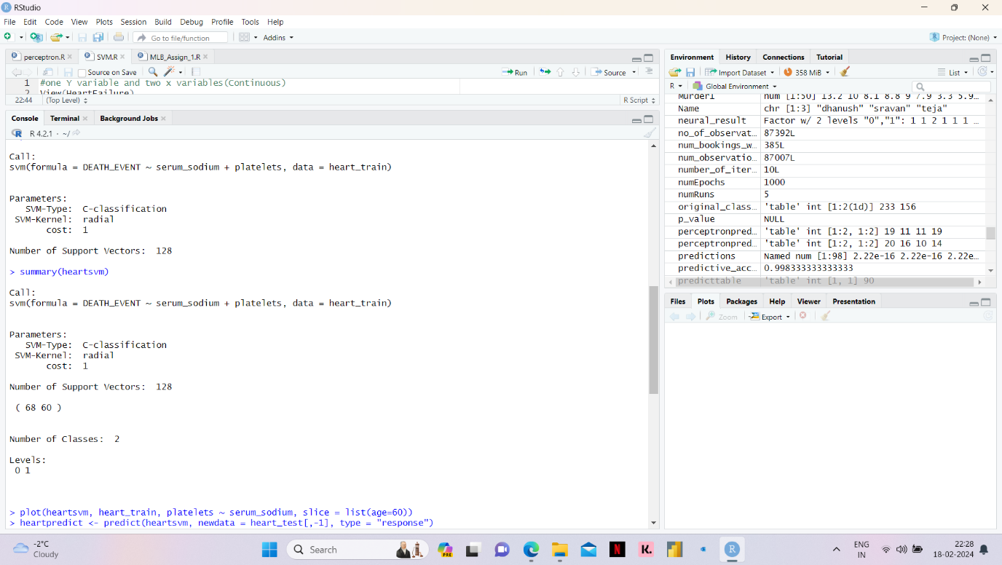
SVM - I
We trained an SVM model on a heart failure dataset with two continuous variables, serum_sodium and platelets, to predict the Death event. This enabled us to create a model with two continuous x-variables and Death event as the y-variable, and then assess its accuracy by predicting death events on the testing dataset.

Slide 23
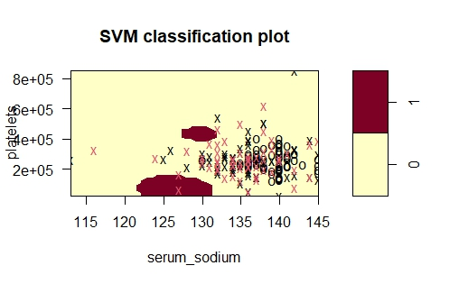
SVM - I

Slide 24
Accuracy of SVM - I

Slide 25
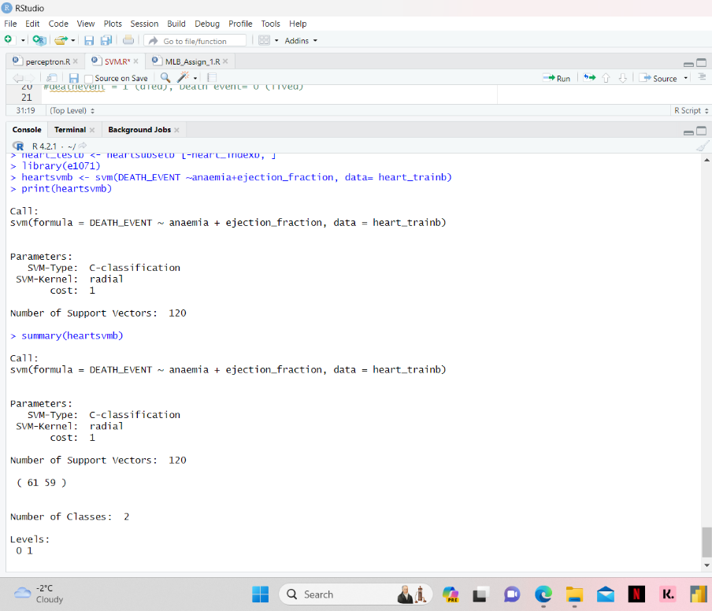
SVM - II
We trained an SVM model on a heart failure dataset with two independant variables, anaemia, ejection_fraction to predict the Death event. This enabled us to create a model with two x-variables and Death event as the y-variable, and then assess its accuracy by predicting death events on the testing dataset.

Slide 26
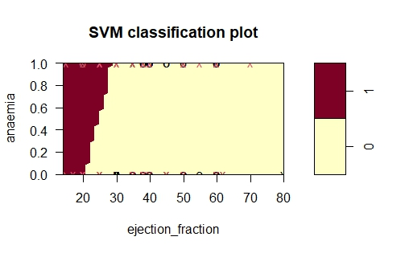
SVM - II

Slide 27
Accuracy of SVM - II

Slide 28
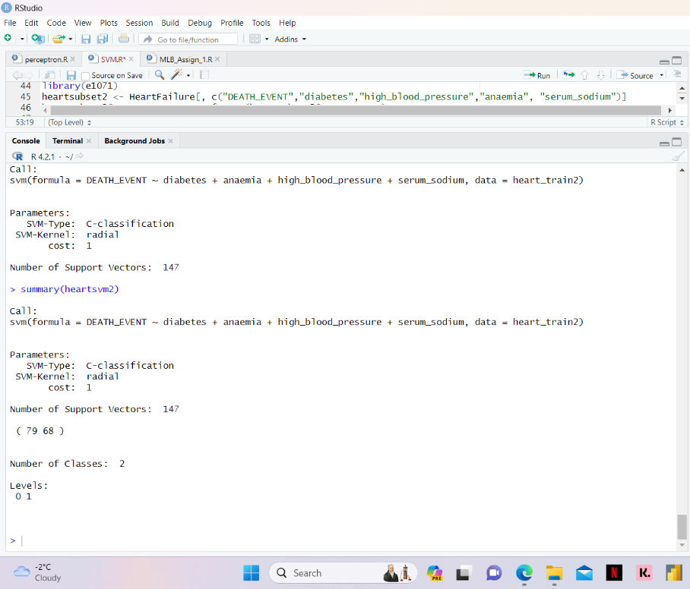
SVM - III
We trained an SVM model on a heart failure dataset with t independant variables, anaemia, diabetes, high_blood pressure and serum sodium to predict the Death event. This enabled us to create a model with multiple x-variables and Death event as the y-variable, and then assess its accuracy by predicting death events on the testing dataset.

Slide 29
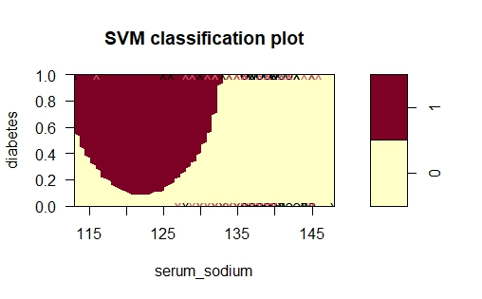
SVM - III

Slide 30
Accuracy of SVM - III

Slide 31
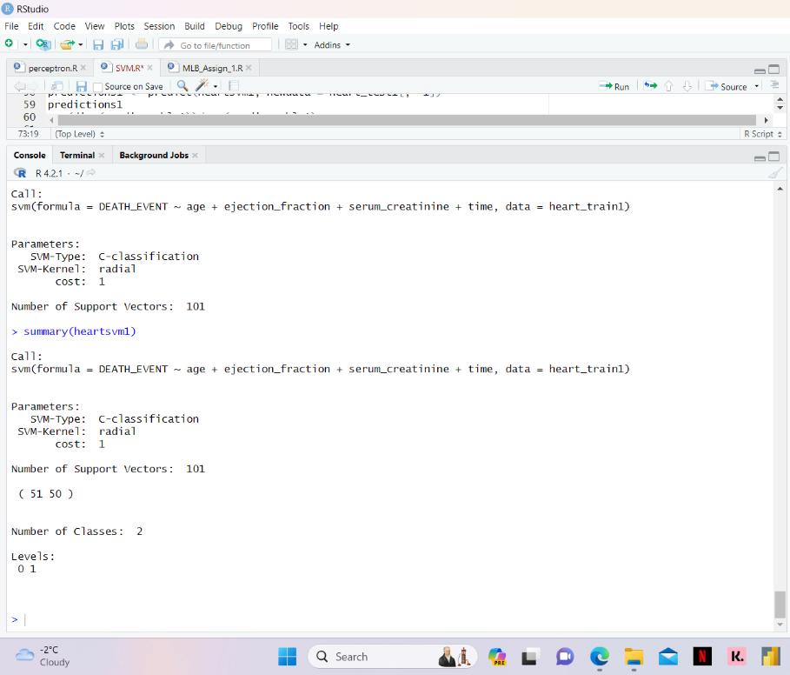
SVM - IV
We trained an SVM model on a heart failure dataset with multiple independant variables, age, ejection_fraction, serum_creatinine and time to predict the Death event. This enabled us to create a model with multiple x-variables and Death event as the y-variable, and then assess its accuracy by predicting death events on the testing dataset.

Slide 32
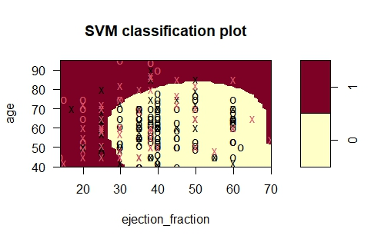
SVM - IV

Slide 33
Accuracy of SVM - IV

Slide 34

SUMMARY OF SVM’s

Slide 35
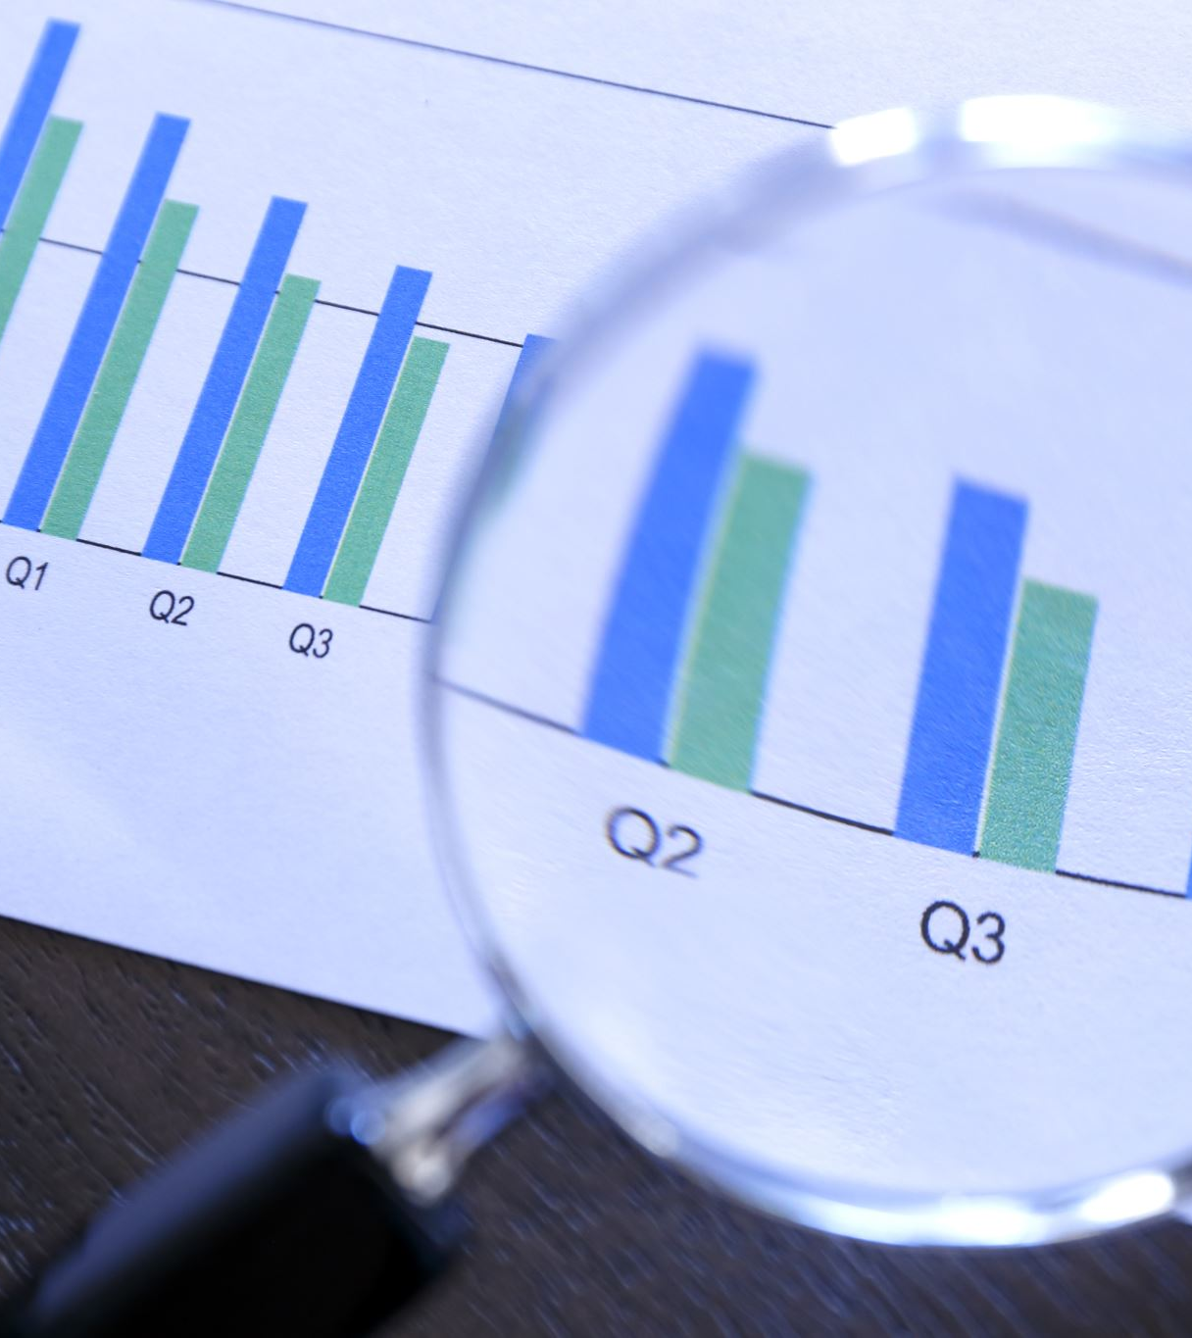
LESSONS LEARNT
Visualizations can be helpful in this specific example
when exploring the relationships between different variables and the Death event outcome. For instance, visualizations can help identify patterns or trends in the data that may inform feature selection or model interpretation.
However, visualizations may not be as useful when dealing with high-dimensional data or when the relationships between variables are complex and not easily visualized

Slide 36
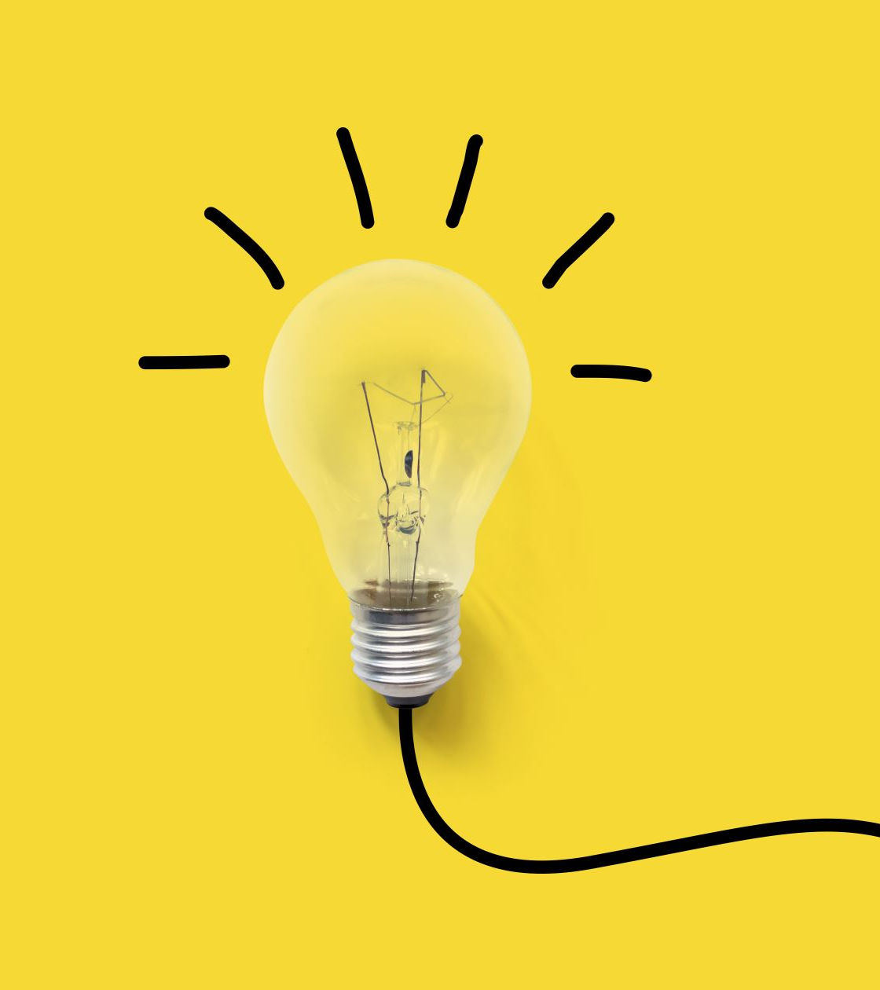
PERCEPTRON OR SVM ?
In this case, both the perceptron and SVM methods showed some success.
The perceptron, being a basic linear classifier, might struggle with complicated relationships between variables or when the data isn't easily separable in a linear manner. This could result in lower accuracy.
On the contrary, SVM, especially with kernel tricks, can deal with non-linear relationships and achieve better accuracy. However, SVM might need more computational resources and could overfit if not adjusted correctly.

Slide 37
Other Techniques
Logistic Regression is also a common method for predicting binary outcomes like Death events. It's easy to understand and doesn't require a lot of computing power, making it good for datasets with a moderate number of features.
Neural Networks: These are advanced models that can find intricate patterns in data, which might lead to very accurate predictions. But they need lots of data and computing power to train and optimize effectively.
Random Forest: It's a technique that combines many decision trees to make predictions. It's good at handling complicated relationships between factors in the data. Unlike SVM, it's quite stable and doesn't easily get too caught up in the specifics of the data, but it might not give results that are easy to understand.

Slide 38

THANK YOU

